Slide 1
The Color of Water
Massachusetts Global Action
Organizing for the Human Right to Water in Boston
Notes:
Connect with previous presentation
MGA is a multi-issue advocacy organization
Concerned with corporate globalization and its impacts on Massachusetts
Work ranges from immigrants rights, through antiwar/peace building, workers rights, supporting the world social forum process and the human right to water

Slide 2
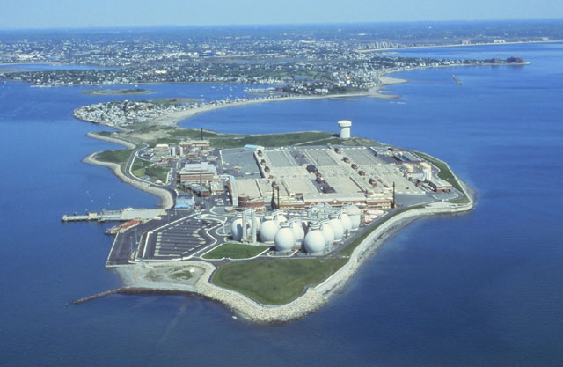
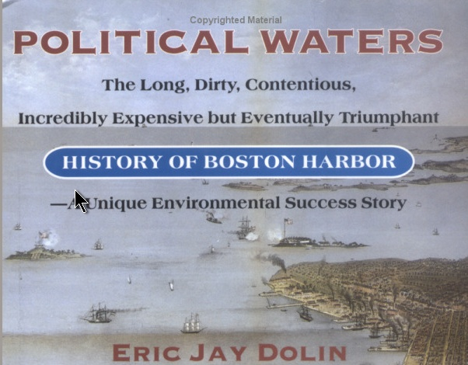
Water Elects Mayor, President
Political football in 1988 presidential elections
Boston’s Mayor Tom Menino first ran on a platform of holding down water rate increases
Throughout the early 90s water, tenants, and landlords connected
www.ColorOfWater.org

Slide 3
Water’s Institutional Cycle
Environmental Regulatory Agencies
Environmental Protection Agency (Federal)
Mass Dept of Environmental Protection (State)
Department of Food & Agriculture (State)
Mass Water Resources Authority (MWRA, state)
Boston Water & Sewer Commission (BWSC, city)
www.ColorOfWater.org

Slide 4
Boston’s Water Suppliers
Mass Water Resources Authority (MWRA)
State controlled, possible privatization target
“Wholesaler” supplies most of eastern Mass
Multi-billion dollar debt; forecasts price increases
Boston Water & Sewer Commission (BWSC)
Created in 1977, radically improved efficiency
Funded by fee for services
Mayor appoints 3 commissioners
City Council power is unclear
www.ColorOfWater.org

Slide 5
Policy on Non-payment
Relatively low-priced, equitable distribution of services
About $50/month
Collections are processed in house
Exemptions for illness and age
But, no provision for:
Employment status
Income or welfare status
Presence of children, minors
Family, household situation
www.ColorOfWater.org

Slide 6
Cut offs, 2003 - 2006
www.ColorOfWater.org

Slide 7
Sharp Inequalities Across Boston’s Neighborhoods
Neighborhoods | Threatened Cutoffs | Percent of Population Affected
Roxbury - Dorchester: Franklin Field, Grove Hall, Codman Square, Lower Mills, Meeting House Hill, Adams Street; Roxbury Highlands, Franklin Park; Hyde Park, Readville, Mattapan | 42 per 1,000 residents | 16%
S. Boston, Broadway-Marine Park, Andrew Square, East Everett; Jamaica Plain, Pondside, Arboretum; East Boston; West Roxbury; Roslindale | 18 per 1,000 residents | 7%
Charlestown; Downtown; Back Bay; Beacon Hill; West Fens; Brighton; Commonwealth; Prudential; East Fens; Medical Area | 5 per 1,000 residents | 2%
www.ColorOfWater.org

Slide 8
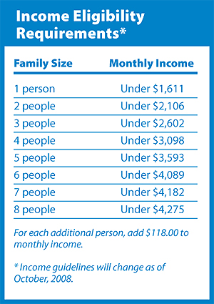
Atlanta, Detroit & Portland
Very different approaches to providing assistance
Atlanta: City-based charity provides assistance
Detroit: Provisions for welfare status
Portland: Income-based public assistance through city
Portland’s income guidelines
www.ColorOfWater.org

Slide 9
Our Project
Get City of Boston to implement the human right to water
Guarantee a lifeline supply of water to each household
Make provision for emergencies to ensure that all residents have water
Protect and conserve water sources
Local action supports global claims, calls into question current US admin’s position
www.ColorOfWater.org
Notes:
Recognize and implement;

Slide 10
5 Elements to Strategy
Build a city-wide network of grassroots organizations
Engage the BWSC and MWRA in a dialogue about the human right to water
Work with the Boston City Council and Mayor’s Office
Build a state-wide network of individuals and organizations
Generate public awareness and deepen education about water
www.ColorOfWater.org
Notes:
Note where we are in each element; resource generation; inter-organizational communication; conclude

Slide 11
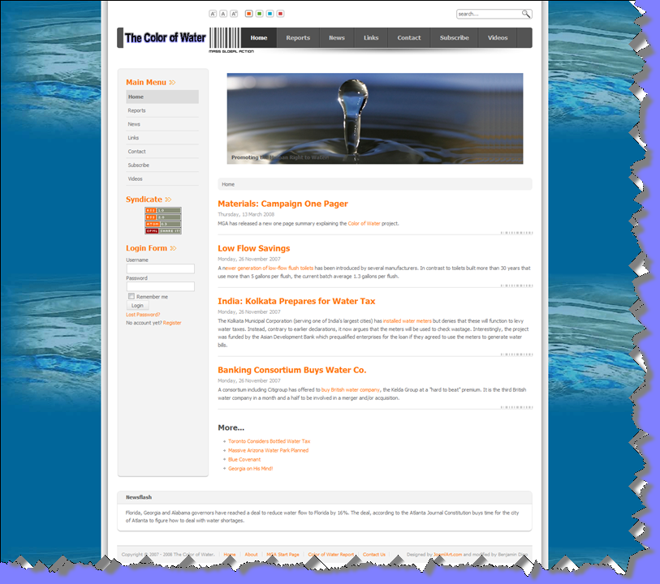
www.ColorOfWater.org
Provide campaign updates
Summarize current developments
Engage organizations, media & policy makers
Become a public education portal

Slide 12
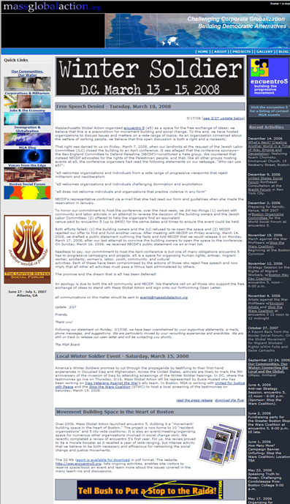
www.MassGlobalAction.org
Multi-issue site
Summarize organizational work
Links to other MGA work
Directed toward other organizations and allies

Slide 13
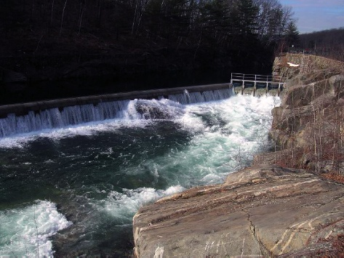
www.ColorOfWater.org

